Slide 1
Devaluation of Crude Oil and its Impact on World Economy
Group 9

Slide 2
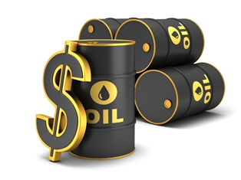

Slide 3
Content
Introduction
Reasons for decline in oil prices
Financial Implications
Macroeconomic effects
Oil exporting countries
Oil importing countries
Effects on world economy
Conclusion
References

Slide 4
Introduction
Crude oil often called “Black gold” is naturally occurring,unrefined petroleum product composed of hydrocarbon deposits.
Trade of crude oil across the globe is one of the major factors in determining the G.D.P(gross domestic product) and financial policies of various countries occurring across the globe.
Devaluation of crude oil means official lowering of the value of crude oil.

Slide 5
What is crude oil ?
The name petroleum covers both naturally occurring unprocessed crude oil and petroleum products that are made up of refined crude oil.
Crude oil varies greatly in appearance depending on its composition. It is usually black or dark brown (although it may be yellowish, reddish, or even greenish). In the reservoir it is usually found in association with natural gas, which being lighter forms a gas cap over the petroleum, and saline water which, being heavier than most forms of crude oil, generally sinks beneath it. Crude oil may also be found in semi-solid form mixed with sand and water, as in the Athabasca oil sands in Canada, where it is usually referred to as crude bitumen.

Slide 6
Current Scenario
The depreciation in crude oil price in global market continues. More entry of unrefined oil in the global market and less usage had adversely affected the price of oil.The Saudi Oil Company Aramco decreased the oil price by one dollar per barrel. The depreciation in the economic growth of China and Europe has also been a factor in the price fall. The depreciation in crude oil price will help government to gain huge amount in the subsidy rate.

Slide 7
Recent Overview of crude oil
Oil prices fell sharply in the second half of 2014
Four-year period of stability around $105 per barrel
From june 2014,the global oil prices started a trend of downward shift
From $115 per barrel touched a low of $45 per barrel in Jan 2015
This decline being the largest since the 2008 decline when prices fell from a whooping $145.85 per barrel to $32 per barrel

Slide 8
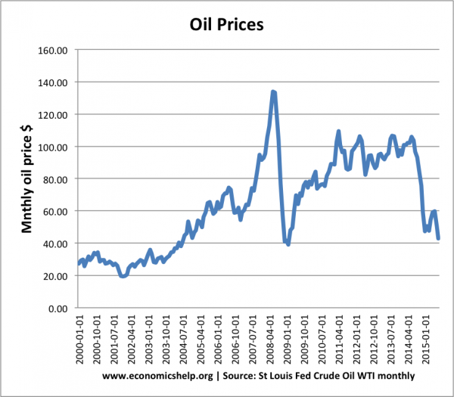
Plot of crude oil prices in last 10 years

Slide 9
Why are the prices of oil dropping and why now?
The oil industry has a history of booms and busts. It is in its deepest downturn since the 1990s, if not earlier.Major reasons for drop of oil are:
1. Supply and Demand
2. Role of OPEC
3. Strengthening in US Dollar
4. Middle East Countries are back

Slide 10
1. Supply and Demand:
Technological shift from vertical to horizontal drilling in US led to it becoming a producer from a consumer.
Major boom in shale gas production causes the production increase by 0.9 million barrel per day.
Between july and december 2014 , the demand has decreased by 0.8 million barrel per day.
The production of oil has increased by 0.9million barrel per day but the demand has decreased.
The US is producing plenty amount of oil than the OPEC and Russia. But the demand from the developed countries is not much.

Slide 11
2. OPEC’s role in reducing price:
OPEC let the prices decrease.
OPEC decreased the prices of oil because it has a new competition coming in market. USA was its competition.
Thus to increase the demand of the oil they produced, the OPEC decreased their oil prices.
Whereas, USA couldn’t decrease the prices because it had less production. If they decrease the price then they would suffer a loss.

Slide 12
3. Strengthening Dollar
Across the globe, oil is bought and sell in dollars.
Dollar getting stronger, buying oil from any other country rather than OPEC becomes expensive. Thus the demand decreases. And thus to increase the demand, the prices are decreased.
Thus this is how the dollar was a factor for decrease in price of oil.

Slide 13
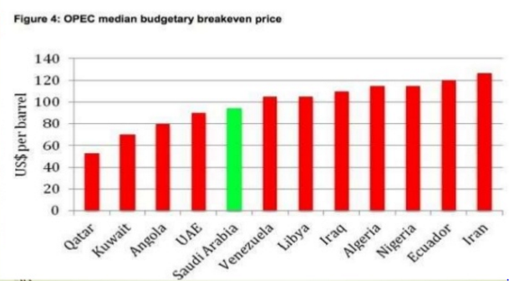
US$ per barrel for different countries

Slide 14
Financial Implications
Input Costs
Real Income Shifts
Monetary and fiscal policies
Global growth
Reduced investment in new development

Slide 15
Input Costs
Lower oil prices reduce energy costs generally, as prices of competing energy materials are forced down too.
Oil is feedstock for various sectors, including petrochemicals,paper,and aluminium,the decline in price directly impacts a wide range of processed or semi-processed inputs.
The transportation,petrochemicals,and agricultural sectors,and some manufacturing industries , would be major beneficiaries from lower prices.

Slide 16
Real Income Shifts
Oil price declines generate changes in real income benifiting oil-importers and losses hurting oil-exporters.
The shift in income from oil exporting economies with higher average saving rates to net importers with a higher propensity to spend should generally result in stronger global demand over the medium-term.

Slide 17
Monetary and fiscal policies :
Oil importing countries | Oil exporting countries | Developing countries
Declining oil price may reduce medium term inflation expectations below target Central banks could respond with additional monetary policy which can support growth | Lower oil prices might trigger contractionary fiscal policy measures | May benefit more from a decline in energy input costs. Household inflation expectations in developing economies may also be more respective to changes in fuel prices than in developed countries.

Slide 18
Macroeconomic Effects :
In 2014-15 the price of crude oil has fallen more than 50%.
This fall in the price of oil has a significant impact in reducing transport and other business costs.
Falling oil prices is good news for oil importers,such as Western Europe, China, India and Japan; however it is bad news for oil exporters, such as Russia,Venezuela, Kuwait, Iraq, Nigeria.

Slide 19
Who loses due to decrease in prices?
For starters, oil-producing countries and states. Venezuela, Nigeria, Ecuador, Brazil and Russia are just a few petro-states that are suffering economic and perhaps even political turbulence.
The impact of Western sanctions caused Iranian production to drop by about one million barrels a day in recent years and blocked Iran from importing the latest Western oil field technology and equipment. With sanctions now being lifted, the Iranian oil industry is expected to open the taps on production soon.

Slide 20
Countries supplying Crude Oil (Exporting countries):
According to the International Energy Agency (IEA), in 2012 over 64% of world oil production came from the top five countries:
Russia 544 Mt
Saudi Arabia 520 Mt
United States 387 Mt
Venezuela 206 Mt
Iran 186 Mt
Total oil production was 4,142 Mt, up to 3% from 4,011 Mt the previous year.

Slide 21
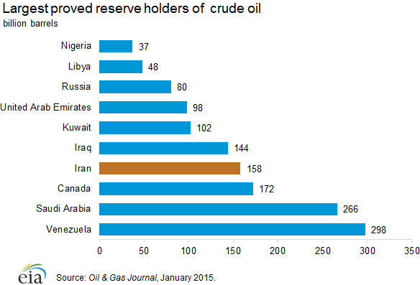

Slide 22
Russia
Russia is world’s largest crude oil.
Russia gains 70% of all tax revenue from oil and gas.
Oil Revenues makes up 45% of the government budget and falling oil prices will lead to a government budget deficit, and will require either higher taxes or government spending.
Russia’s economy is expected to shrink 4.5% next year if oil stays at $60 per barrel
The plunging price of the oil has also caused the ruble’s value to collapse.

Slide 23
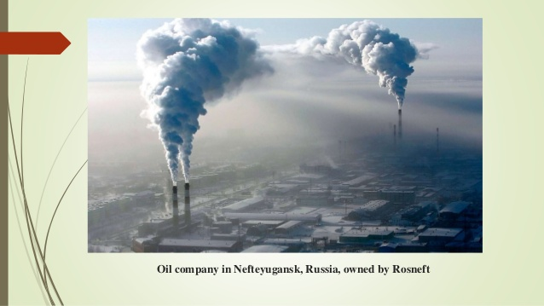

Slide 24
Saudi Arabia
Saudi Arabia is the world’s second largest crude producer after Russia.
It produces 10 million barrel per day.
It will suffer financially from cheap oil.
It oil stays at around $60 per barrel next year, the government will run a deficit equal to 14% of GDP

Slide 25
It can afford temporary falls in oil prices because they have substantial reserves. It has build up a stockpile of foreign currency worth some $470 billion which it will use to finance its deficits
This is why Saudi Arabia has so far not responded by cutting output.
Still, if low oil prices persist , Saudi Arabia may have to cut back on the same of the social programs.

Slide 26
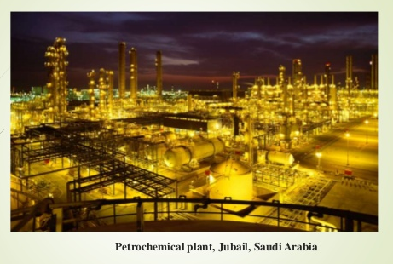

Slide 27
Venezuela
It is another major oil producer.
In Venezuela oil sales provide both 47% of government revenues and the main source of foreign currency.
Venezuela are relying on oil revenues to fund generous social spending.
A fall in oil prices could lead to a significant budget deficit and social problems.
The nation’s economy is set to shrink some 3% this year and inflation is rampant.

Slide 28
Iran
One big problem for Iran is that it needs oil prices well north of $100 per barrel to balance its budget, especially since Western sanctions have made it much harder to export crude.
If oil prices keep falling , the Iranian government may need to make up revenues elsewhere say, by parting back domestic fuel subsidies (always an unpopular move, at least in the short term).

Slide 29
US
In the US fall in crude prices would have more varied impacts
For many people, it will offer a nice economic boost; cheaper oil means lower gasoline prices which have fallen to $2.47 per gallon
However oil producing states like Texas and North Dakota are likely to see a drop in revenues and economic activity
All told , oil prices are likely to be good for 42 states and bad for the other 8.

Slide 30
Nigeria
Nigeria is set to witness its biggest challenge in decades as oil prices collapse by half since late June, posing serious threat to its public budgets, currency stability and economic prospects.
The Federal and state governments are just waking up to this reality even as the major political parties prepare to battle it out in potentially divisive and costly elections come February 2015. The consequences are undoubtedly challenging and could destabilise the country and shatter its chances of dealing with chronic unemployment, and the massive deficits in infrastructure and social service provisions.

Slide 31
It is nation almost totally dependent on revenue and foreign exchange from taxing and exporting just two commodities - crude oil and natural gas
The CBN devalued the Naira from 155 to 168 (to the Dollar), and widened the margin within which it could be allowed to fluctuate from plus or minus 3%, to plus or minus 5%. the CBN hiked up its benchmark interest rate to 13%, and took additional measures to ease the pressure on the Naira.

Slide 32
OPEC
Iran, Venezuela, Ecuador and Algeria have all pressed OPEC, a cartel of oil producers, to cut production to firm up prices. At the same time, Iraq is actually pumping more, and Iran is expected to become a major exporter again.
Major producing countries will meet on April 17 in Qatar, and some analysts think a cut may be possible, especially if oil prices approach $30 a barrel again.

Slide 33
King Salman, who assumed power in Saudi Arabia in January 2015, may find it difficult to persuade other OPEC members to keep steady against the financial strains, even if Iran continues to increase production. The International Monetary Fund estimates that the revenues of Saudi Arabia and its Persian Gulf allies will slip by $300 billion this year.

Slide 34
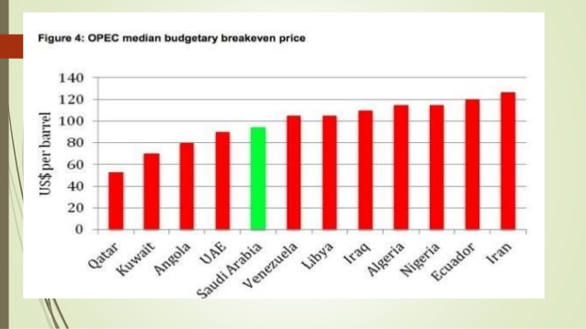

Slide 35
Who gets benefit from the price drop?
Any motorist can tell you that gasoline prices have dropped. Diesel, heating oil and natural gas prices have also fallen sharply.
The latest drop in energy prices — regular gas nationally now averages just above $2 a gallon, roughly down about 40 cents from the same time a year ago — is also disproportionately helping lower-income groups, because fuel costs eat up a larger share of their more limited earnings.

Slide 36
Oil importing Countries
Major Oil-Importing countries are :
China
US
India
Japan
Indonesia
South africa
Turkey

Slide 37
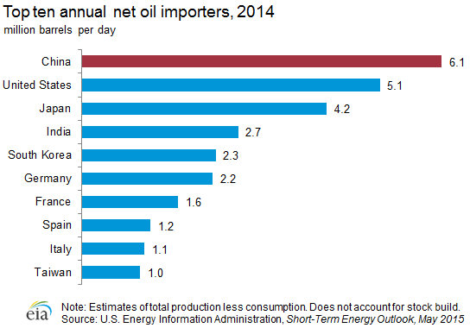

Slide 38
How does devaluation affects them?
There are three major ways through which a decrease in the price of oil affects oil importers.
The first is the effect of increase in real income on consumption.
The second is the decrease in the cost of production of final goods , and in turn on profit and investment.
The third is the effect on the rate of inflation

Slide 39
A 10 % decrease in oil prices would raise growth in oil-importing economies by some 0.1-0.5% points, depending on the share of oil imports in GDP.
In China, for example, the impact of lower oil prices on growth is expected to boost activity by 0.1-0.2 % because oil accounts for only 18 percent of energy consumption, whereas 68 % is accounted by coal.
Japan is also a major importer of oil and oil-related products with imports valued at $210 billion in 2014,roughly equivalent to 4% of country’s GDP.
Several other large oil-importing emerging market economies also stand to benefit from lower oil prices.

Slide 40
In Brazil,India, Indonesia,South africa and Turkey, the fall in oil prices will help lower inflation and reduce current account deficits a major source of vulnerability for many of these countries.
Some oil importers would also be affected by a slowdown in oil-exporting countries.
A sharp recession in Russia would slow down growth in central Asia ,while weakening external accounts in Venezuela or the Gulf Cooperation Council(GCC) countries may put at risk external financing support they provide to neighbouring countries.

Slide 41
Effects on India :
India , which is the fourth largest consumer of oil, is a big beneficiary of falling oil prices.
India imports nearly two-thirds of crude oil requirements.
The reduced prices will not only lower the import bill but also help save foreign exchange.
And it will also enable oil marketing companies to reduce retail prices of petrol and diesel.
As per rough estimated, a $10 fall in crude could reduce the current account deficit by approximately 0.5% of GDP and the fiscal deficit by around 0.1% of GDP

Slide 42
How China was affected?
One of the major consumed petroleum products in China is gasoline, which is impacted by the automobile industry.For the past four successive months, the year-over-year growth in automobile sales has been negative.
China’s oil consumption is an important factor that drives the overall crude oil demand. An increase in crude oil demand is positive for crude tankers and companies .One of the major consumed petroleum products in China is gasoline, which is impacted by the automobile industry. For the past four successive months, the year-over-year growth in automobile sales has been negative.
According to data from CAAM (China Association of Automobile Manufacturers), 1.5 million cars were sold in China in July 2015. This is a 7% fall year-over-year and a 16% fall compared to June 2015. The fall in auto sales, which hampers the crude oil demand, occurred amid the slowdown in the Chinese economy.

Slide 43
Before the yuan devaluation in China, the EIA (U.S. Energy Information Administration) had forecast a growth of around 3% in 2015 and 2016, each in oil consumption. China devalued its currency mainly to boost its exports and support economic growth. China’s goods will now be cheaper for other countries, which will likely increase its exports.
The increase in China’s economic activity will see a higher demand for oil, but it also may impact the economic activity of other countries. Economic growth will also lead to higher automobile sales, which in turn will increase the implied oil demand. CAAM has forecast auto sales to grow by 3% in 2015. If the Chinese yuan devaluation is successful and achieves its objective, we can see higher economic activity and a higher demand for crude oil.

Slide 44
Will china’s oil imports keep on rising?
The United States and China are in close competition to be the world’s top crude oil importer.
In June, China was the top importer of crude oil imports at 7.2 MMbpd (million barrels per day). In July, China continued its import pace. Higher imports were due to China’s stockpiling of crude oil. Because of this, the crude tanker demand rose, which benefited the crude tanker industry.

Slide 45
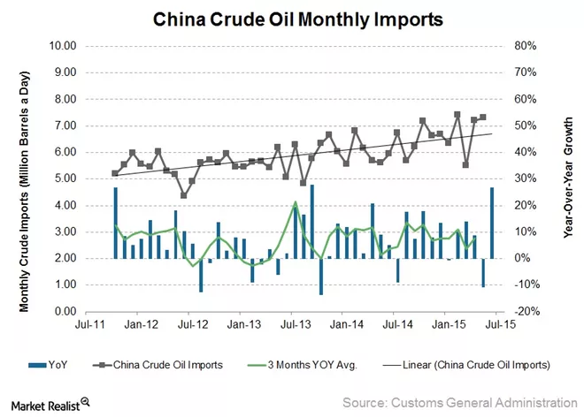

Slide 46
Fewer ships sailing to China
Nigeria has banned approximately 113 tankers from entering Nigerian waters. According to industry analysts, many of these banned tankers have traded with China. On August 6, Platts reported the volume of ships sailing to China was 57 compared to 71 the previous week. The Nigerian ban may be one of the reasons for the decreased number of ships sailing to China. This may have a temporary negative impact on China’s crude oil imports.The demand for crude oil has experienced a setback since few Asian refineries undergo seasonal maintenance and because of a weak seasonal demand. Asian refineries are also experiencing tough competition from Saudi Arabia. We’ll look at this in greater detail in the next article.

Slide 47
This fierce competition has further reduced crude oil demand in Asia, which is reflected in tanker rates. Tanker rates are at their lowest for the last nine months. According to the MJLF Weekly Tanker Spot Market Scorecard, the VLCC (very large crude carriers) rate for the route from West Africa to China for the week ended August 14 was $46,500 per day. This compares to $48,000 per day for the prior week. The 21-day average rate for the same route was $65,500.

Slide 48
Is there a conspiracy to bring the price of oil down?
There are a number of conspiracy theories floating around. Even some oil executives are quietly noting that the Saudis want to hurt Russia and Iran, and so does the United States — motivation enough for the two oil-producing nations to force down prices. Dropping oil prices in the 1980s did help bring down the Soviet Union, after all.
Normally, when there is a mismatch between supply and demand in the oil market it is left to the “swing producer” -Saudi Arabia- to raise production, or bring it down, so as to stabilize prices. Not only have the Saudis refused to do so this time around, but they unilaterally cut prices to discourage US and other producers, now able to squeeze oil from “tight”, high-cost and deepwater fields, and even tar sands. Oil would likely remain depressed, and fluctuate around $55 to $60 a barrel.

Slide 49
But there is no evidence to support the conspiracy theories, and Saudi Arabia and the United States rarely coordinate smoothly. And the Obama administration is hardly in a position to coordinate the drilling of hundreds of oil companies seeking profits and answering to their shareholders.

Slide 50
When oil prices moves up?
Inflation Increases
Govt. Spending on subsidy increases
Foreign currency reserves reduces
Our export becomes weaker
GDP is affected negatively
Share market crumbles
Investment decreases

Slide 51
Steps taken by government
Provided huge amount of subsidies to oil companies to keep them solvent.
This is increased domestic prices of diesel and petrol.
Start looking for alternative energy options to prevent future oil shocks.
Increase in CRR , Repo Rates.

Slide 52
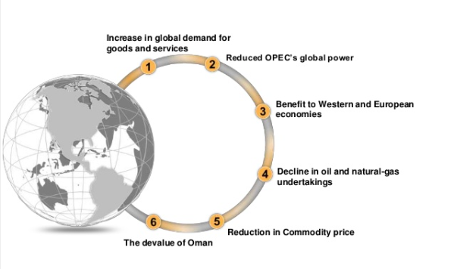

Slide 53
When are oil prices likely to recover?
Not anytime soon. Oil production is not declining fast enough in the United States and other countries, though that could begin to change this year. But there are signs that supply and demand — and price — could recover some balance by the end of 2016.
Oil markets have bounced back more than 40 percent since hitting a low of $26.21 a barrel in New York in early February.
Some analysts, however, question how long the recovery can be sustained because the global oil market remains substantially oversupplied. In the United States, domestic stockpiles are at their highest level in more than 80 years, and are still growing. But over the long term, demand for fuels is recovering in some countries, and that could help crude prices recover in the next year or two.

Slide 54
Industry stock performance
The average crude tanker stocks have gained 35% from the start of the year, but they saw a sharp decline since the end of July. On August 13, the average crude tanker stocks were down by 7% compared to the last trading day of July. The top loser was Frontline (FRO), which recorded a change of -18% from the last trading day of July.

Slide 55
BDTI
The BDTI tracks shipping rates for transportation of unrefined oil on representative routes. Researchers and analysts follow the BDTI to assess crude tanker companies’ revenues and earnings potential. On July 1, 2015, the BDTI was at 952 points, the highest in July. Then the index took a free fall and hit 752 points on July 31, the lowest level recorded for the month of July.
The BDTI free fall continued, and on August 12, the BDTI stood at 673. The index has been showing a falling pattern since the beginning of August. On August 13, the monthly BDTI recorded a 10% decline on a year-over-year basis. The decline was immediately reflected in stock prices.

Slide 56
There are signs, however, that production is falling because of the drop in exploration investments. RBC Capital Markets has calculated projects capable of producing more than a half million barrels a day of oil were cancelled, delayed or shelved by OPEC countries alone last year, and this year promises more of the same.
But the drop in production is not happening fast enough, especially with output from deep waters off the Gulf of Mexico and Canada continuing to build as new projects come online.
On the demand side, the economies of Europe and developing countries are weak and vehicles are becoming more energy-efficient. So demand for fuel is lagging a bit.

Slide 57
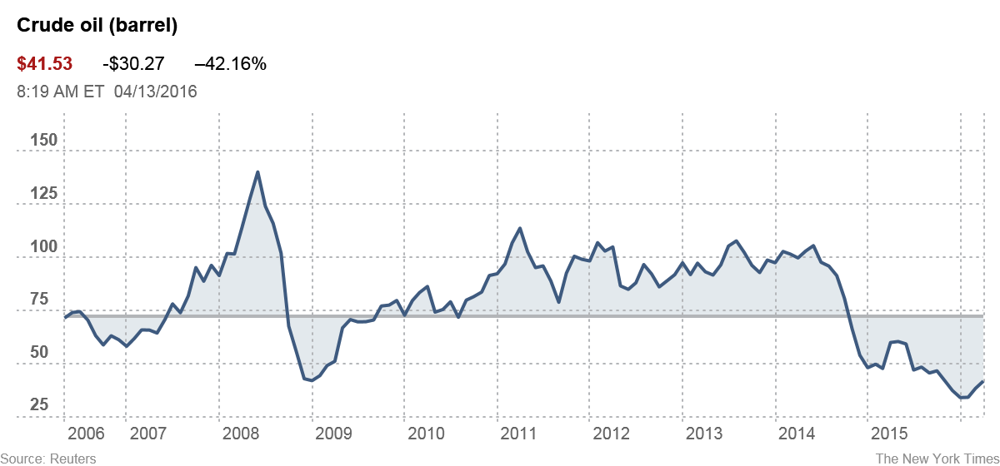

Slide 58
Conclusion
Following four years of stability at around $105 per barrel, oil prices fell sharply in the second half of 2014.
The decline in oil prices was quite significant compared with the previous episodes of oil price drops during the past three decades.
There have been a number of long-terms and short-term drivers behind the recent plunge in oil-prices : several years of large upward surprises in oil supply ; some downward surprises in demand;change in OPEC policy objectives; and appreciation of US dollars.

Slide 59
References:
http://www.nytimes.com/interactive/2016/business/energy-environment/oil-prices.html?_r=0
http://www.slideshare.net/HasnanBaber/why-oil-prices-failing
http://www.investopedia.com/ask/answers/030315/why-did-oil-prices-drop-so-much-2014.asp
http://www.slideshare.net/satyammishra127648/declining-crude-oil-pricing
http://www.investopedia.com/articles/investing/122115/chinese-yuan-devaluation-can-impact-india.asp
http://www.economicshelp.org/blog/11738/oil/impact-of-falling-oil-prices/

Slide 60
Thank You
Rupam Jogal (1401003)
Rushita Thakkar (1401004)
Charmi Kalani (1401067)
Ishika Agarwal (1401069)
Twinkle Vaghela (1401106)
Nivedita Rao (1401100)
Himani Patel (1401111)
Honey Gadhiya (1401112)

